Slide 1
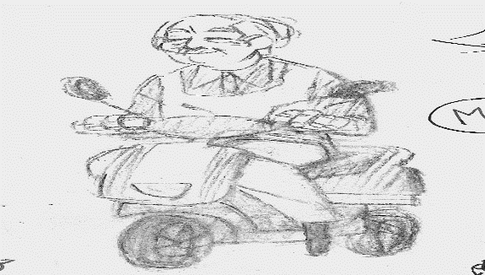
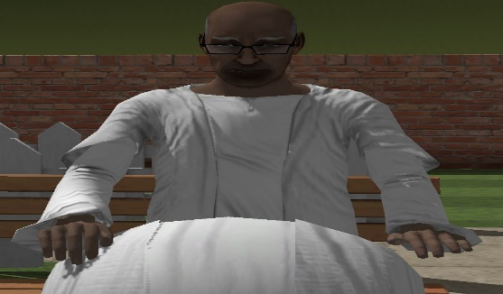
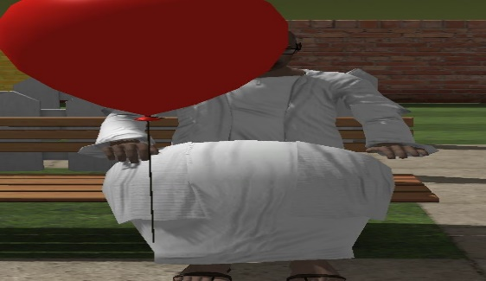
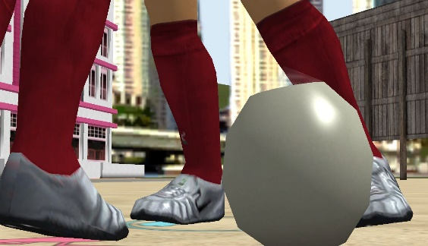
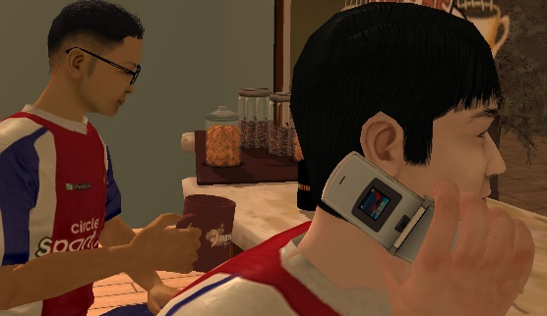
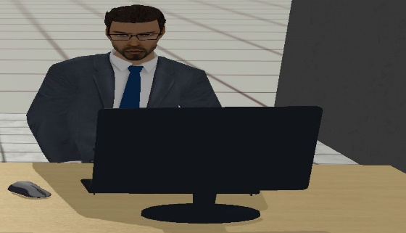
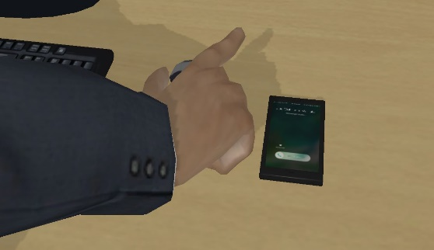
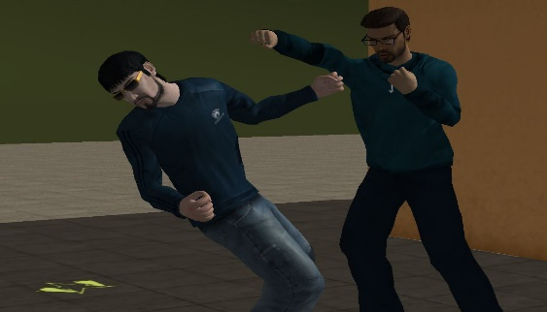
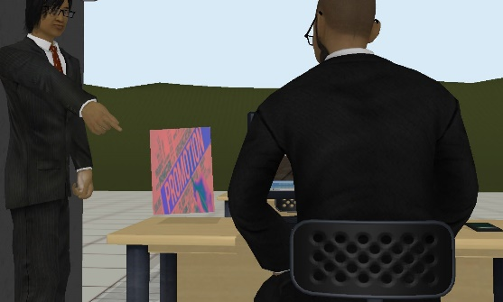
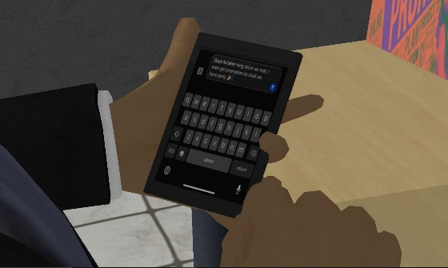
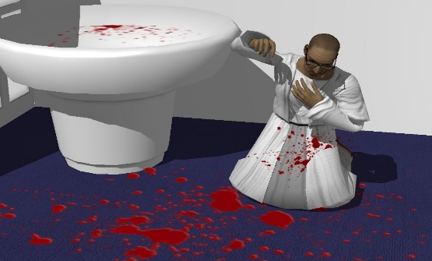
MONTAGE
Page:
Man parking his scooter
After that he walks and he sits then (He sees the environment )
The old man thinks about the past and one balloon flies near his face
Past, the old man is 16 years old and he plays football with his friends
After playing he goes to the supermarket and grabs a drink
He is 22 years old and working on a project
His phone is ringing (His best friends are in the conference call )
He is fighting with his friends (punch)
He is looking at his phone to contact his friends and having thoughts on throwing a party
Age 40
He is diagnosed with cancer; he spits blood in his restroom
At age 40 he gets the promotion

