Slide 1
‘Critical analysis of Irandu Disaigal ‘
A level media

Slide 2
How does your product use or challenge conventions and how does it represent social groups or issues?

Slide 3
Conventions of Gangster (Used by many professional filmmakers)
Crime and Gangster Films are exhibited around the evil actions of criminals or gangsters, especially bank robbers, gang Dom figures, or cold gangsters who act outside the law, stealing and violently murdering their way through life. In the 1940s, a distinct type of crime thriller developed, more dark and skeptical - Criminal and gangster films are frequently characterized as post-war film noir or detective-mystery films - because of underlying relationships between these cinematic forms. Crime flicks encompass or pass over many levels, and may comprise at least these different types of films: the gangster film, the detective film, the crime comedy, the suspense-thriller, and the police film.
Violence and murder are often seen in many gangster films because they both represent power and authority
furthermore, the effect the spectator feels from scenes of brutality would be that of disgust but also comprehend that these are fundamental scenes in placing the gangster within the film.
Another convention of the gangster genre would be the advantage of wealth, again being wealthy in a gangster movie implies that the antagonist (gangster) has more control and authorities, therefore filmmakers tend to make the antagonist look like a more powerful figure within the film.
Money is also used as a system of making a gangster lifestyle more appealing to the spectator, as ordinarily in the films the gangster has a classic, an expensive car which makes them appear more appealing as a hero rather than someone would do bad things for a particular gain.
Costume & Make-Up Regular outfits like suits and ties are one of the most recognizable conventions in gangster films. High-end Clothes are frequently seen when women are concerned. The color red often binds in with these outfits also. Makeup in gangster films commonly consists of blood and scars. Red lipstick is also observed considerably and usually on women. Props The most regularly observed props in gangster films are guns, cigarettes, drugs, and money. These often balance into the storyline and theme of gangster films (especially money).

Slide 4
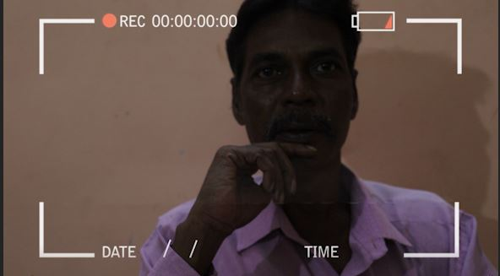
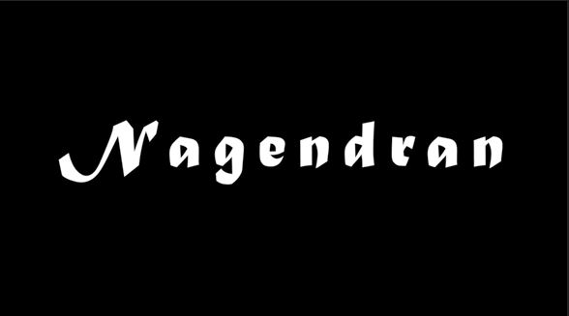
Film opening
IRANDU DISAIGAL constantly follows various conventions in a film opening in terms of
Establishing characters- the intro scene is an interview scene (Present) in which a main narrator of the flashback is established (Ganeshan) and he narrates the past of the character Nagendran
As the film holds an non linear narrative line therefore to differentiate each character and make the audience to understand about characters narrative I have equipped an editing technique of showing the characters name before his scene commences ultimately this makes the audience to understand the narrative clearly

Slide 5
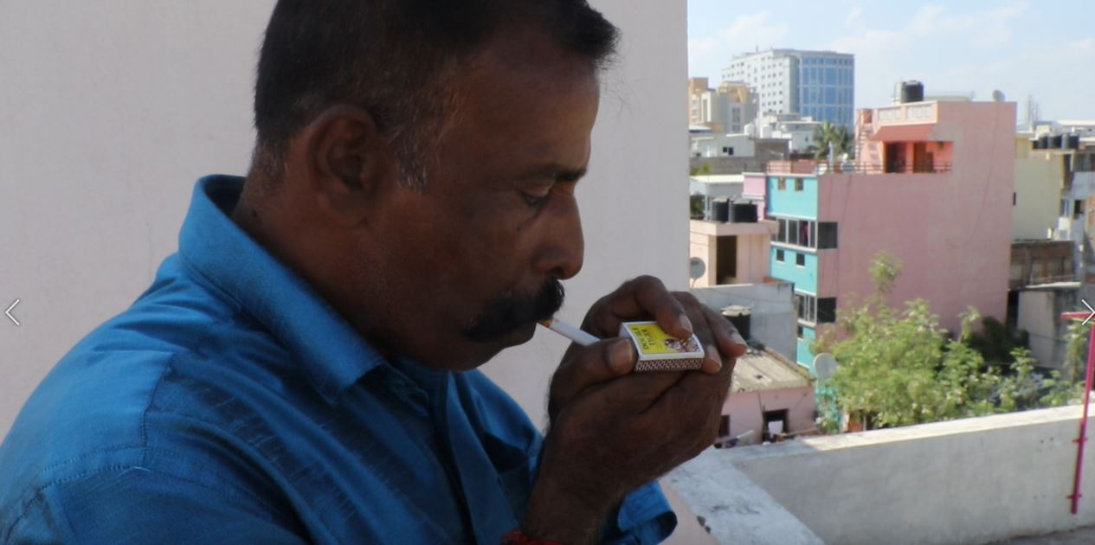
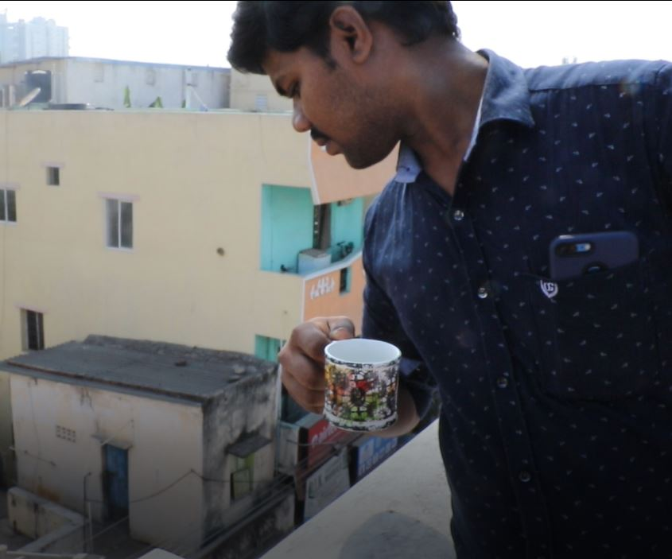
Characterization
Irandu DISAIGAL HOLDS two prominent characters IN WHICH THE NARRATIVE REVOLVES AROUND
NAGENDRAN- Is represented with an cigarette because it is one of the main prospects most of the film makers utilize in terms of gangster plots to show the gangster in high authority and power.
NAGENDRAN-
Nagendran a well known rough gangster, as well as a Don (gang leader) he rules the area known as Veeramani Salai, his main job in the area
Is to keep everyone safe from outside invaders such as politicians who attempt on obtaining land.
He primarily supports people within the area on behalf of various problems, however he looks rough outside, but he is very sensitive inside he craves a peaceful environment.
Many other people are abreast of him and they are looking forward to killing him, but no one can touch him as he is a very powerful Don, who has many bodyguards around him he can attack 10 people as a solo.
ASHWIN-
Nothing quite about this character just an usual graduate who has a big dream to get settled in life, and looks for a job however he also blames the subject he chose (Engineering) I characterised this character from the ideology of present situations of engineering graduates in Chennai who are really searching for job and failing to get one

Slide 6
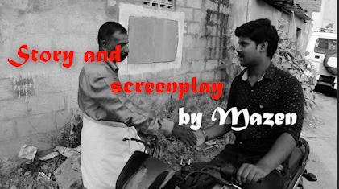
Iconic shots
IRANDU DISAIGAL had a couple of shots, but it had ONE important iconic shots
These certain shots are prominent in filming, this primarily exposes a particular shot which speaks about the most significant film moments that encapsulates the complete film and that is retained by the society as remaining symbols of the movie. Essentially, everybody is struggling to make every significance in the film memorable.
Iconic shot in Irandu Disaigal is taken during the meeting of both main characters as stated each one have their own narrative line but meeting of two characters is an main criteria in the whole plot line.

Slide 7
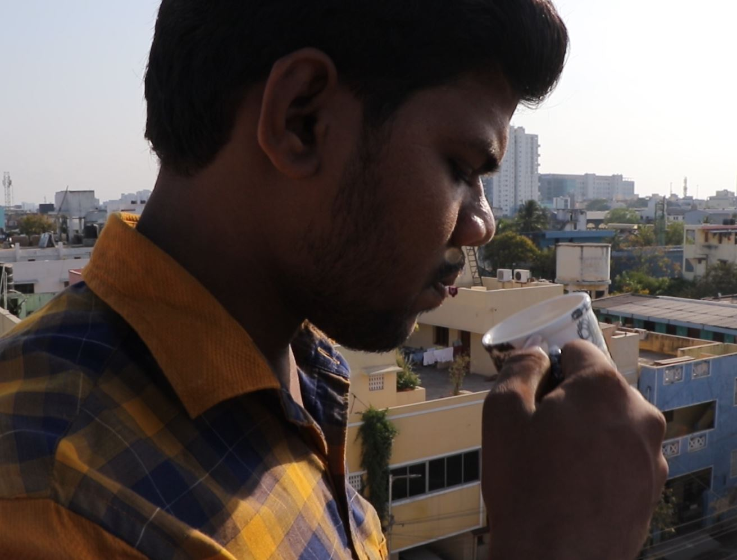
Shots and angles
IRANDU DISAIGAL had various shots and angles
The most prominent shots used in this film was Closeup, Mid-shot, tracking and pan these shots are mainly utilized to the Two characters Nagendran and Ashwin because each them hold an important aspect in narrative line and each hold their backstory therefore to balance both I equipped almost same shots and angles
To show equal screen space I utilised same shots and same angle for two characters

Slide 8
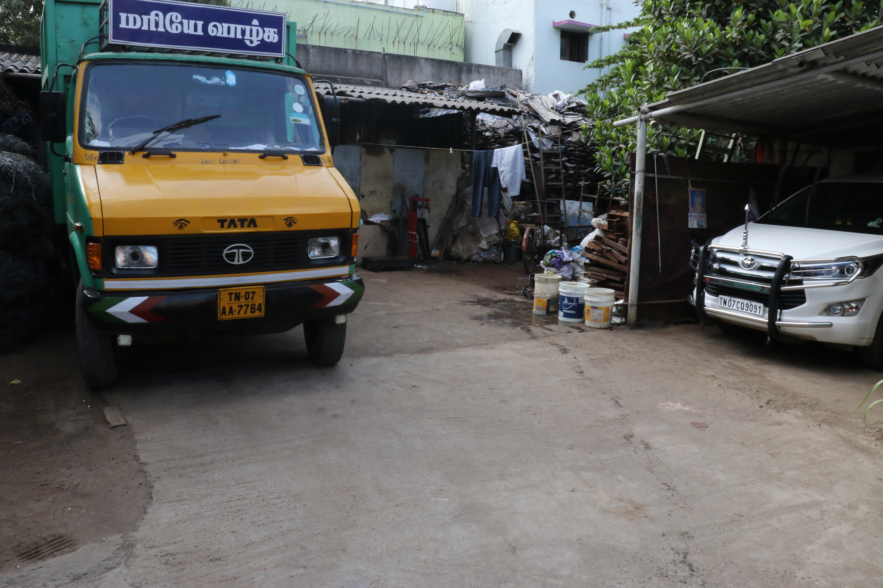
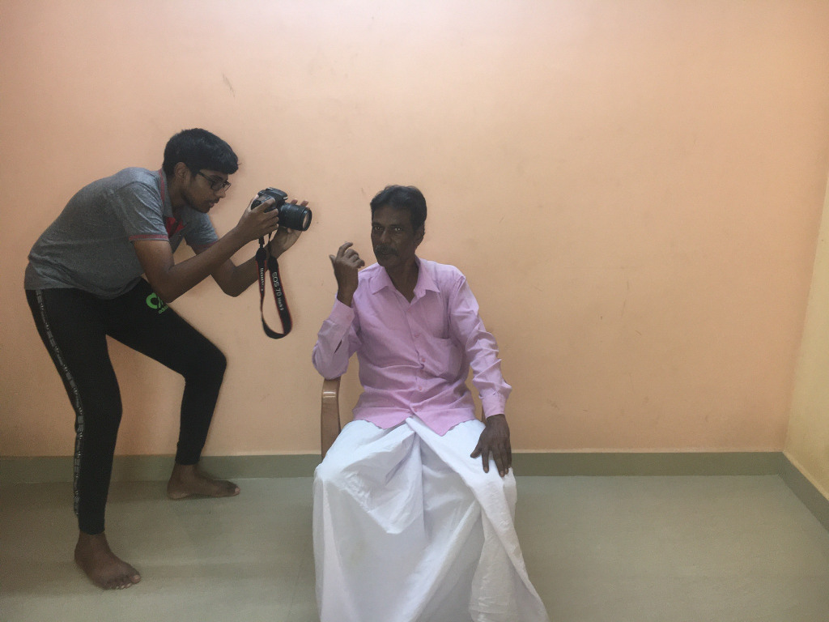
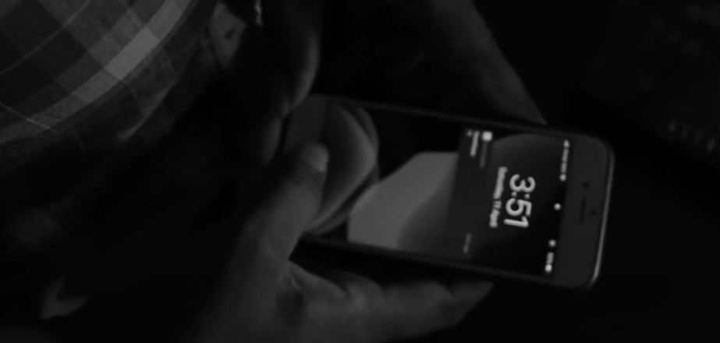
Location
IRANDU DISAIGAL was taken in FOUR desperate spots BUT IN SAME STREET
This is final location of the film where death of main character has been shot
This shot was taken in the terrace/Balcony
This is the intro shot which was taken in my home by using tube light as key lighting and I used extreme close-up to shoot this scene
This is an interior shot, and this was taken as close-up

Slide 9

Social issues
• This film holds a minimum amount of social issues. This basically states and shows the local citizens of Chennai and their culture in terms of language and their normal behaviours like their way of communicating adapting to every place they visit and behave as themselves where ever they go and helping minds it also represents their dress codes. The main set of the film is represented as north of Chennai therefore the whole film retains north Chennaites.

Slide 10
How does your product engage with audiences and how would it be distributed as a real media text?

Slide 11
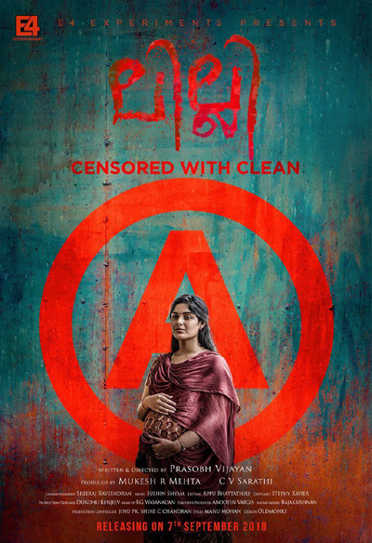
The target audience
The target audience for Irandu Disaigal is largely based on Adults as well youngsters , local audience and mid age people around the globe because according to the reports Gangster genre holds a very big demand from these set of age groups and it wont be a family entertainer so it would not grab their attentions but a person who reads a couple of Gangster fiction novel gets influenced by this film as this film holds a larger and many characters and it would also grab various film lovers and critics because Gangster genre film’s largely equips an intense violence with more gore and blood.
As this film retain more violence it will be certified according to Indian film rights as A and according to MPAA film ratings the film would be certified as A.

Slide 12
How the film engages the audience?
The narrative of Irandu Disaigal is very gripping and very suspense the whole plot is very concoction it does make the audience to get into the storyline and makes them to expect on what would happen next this plot is began as a equilibrium
Irandu Disaigal is a non linear narrative that would engage the audience from the very first moment of character establishment, as the film starts as equilibrium the audience would love to view and comprehend the narrative, as the story is based on non linear it holds various characters and in that two of them pay a vital role
This film will widely cover local citizens of Chennai and for that to be achieved I established the location of urban city with conjoined building within a street and this would probably engage them in addition to it I also equipped the film with native language spoken by many local citizens.

Slide 13

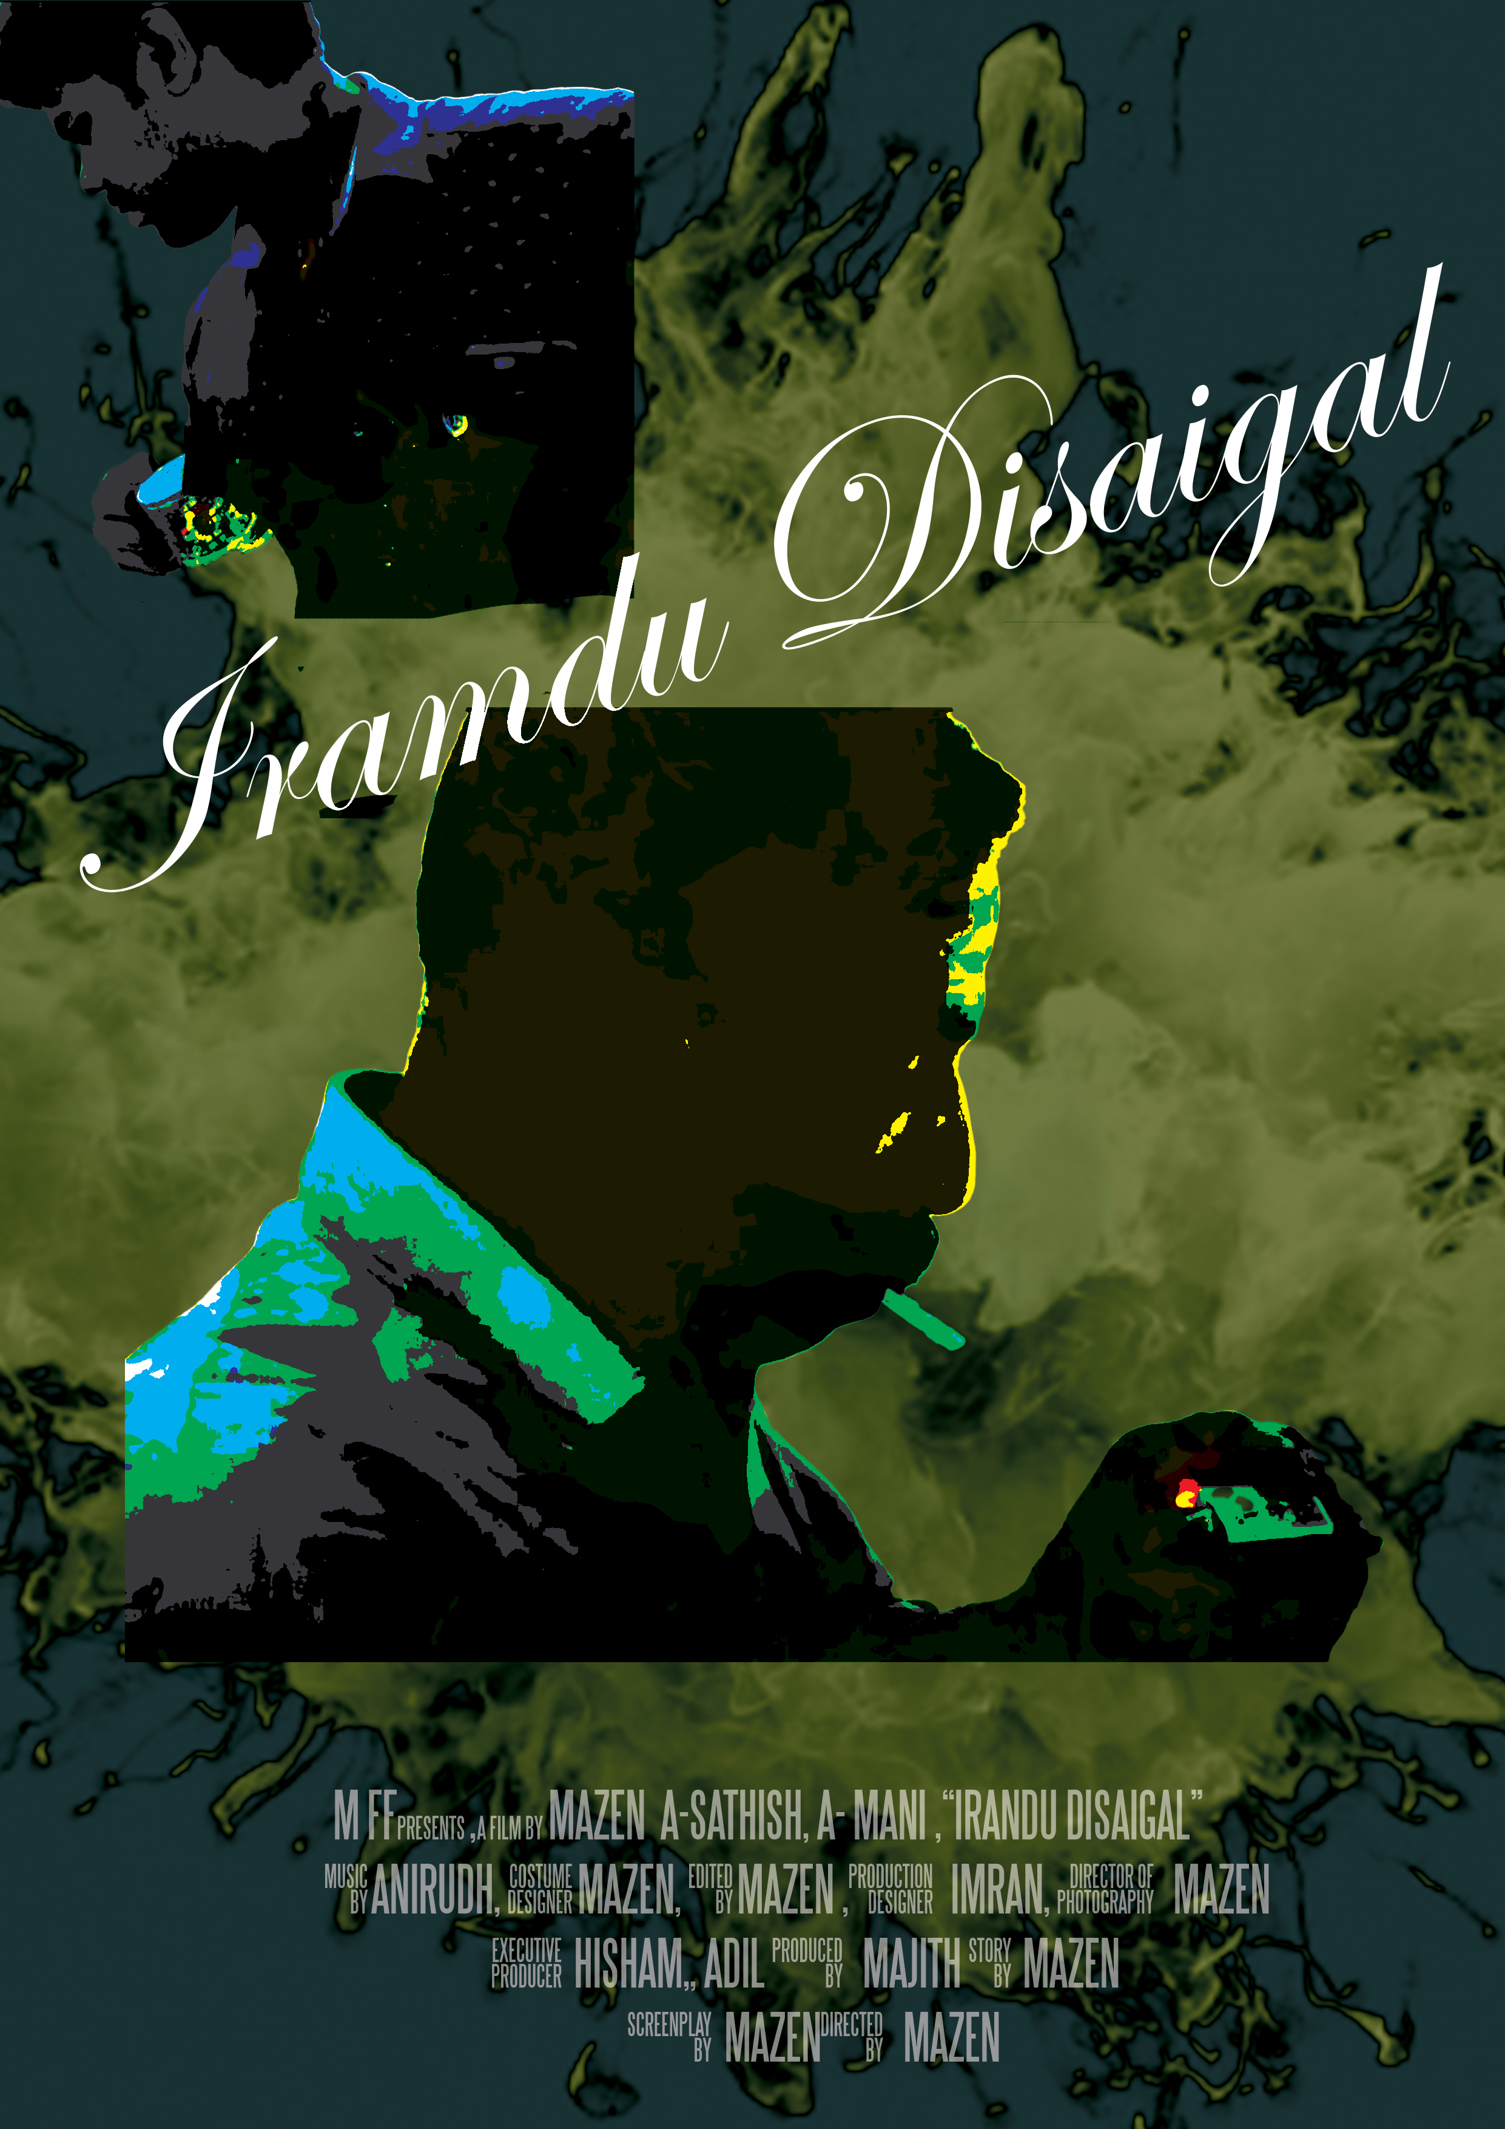


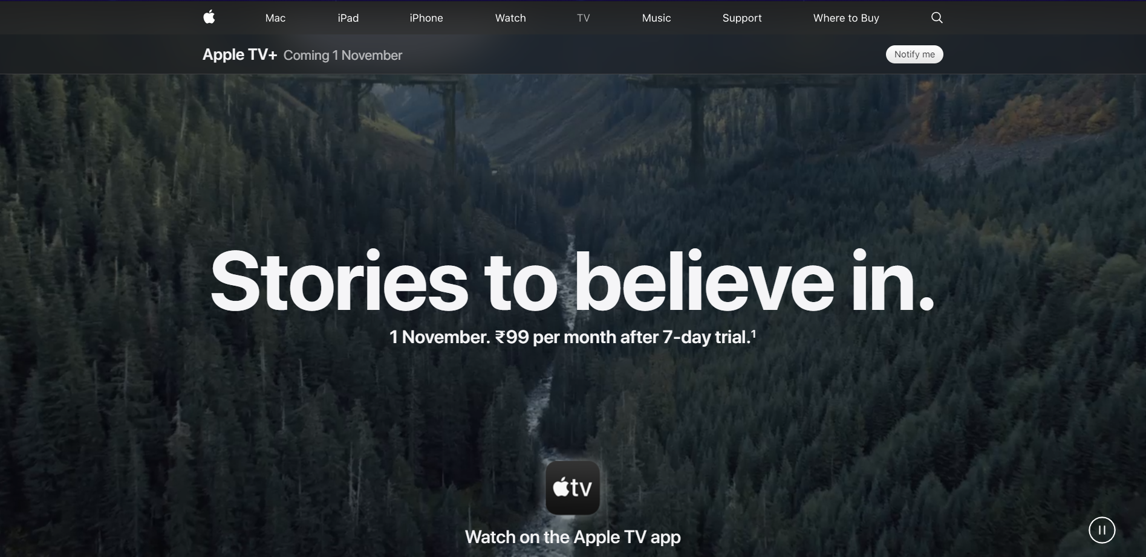
Distribution
IRANDU DISAIGAL would be distributed in various methods by utilizing the platforms of both New media as well as traditional media
As the target audience of Irandu Disaigal is almost Mid age group of people, teenagers and local citizens so I would promote Irandu Disaigal through Television ads (especially in popular channels within national or international ), billboards, posters ,advertisements on all social medias like Twitter and a big banner in a popular location within city line because most of the Mid age groups would not know how to access newer medias therefore to cover them I would promote it by placing huge banner
Theatrical rights for my film will be sold to all over the world as this genre has people who can understand the language all over the world
After the main release of the film I would sell the rights of the film to various video streaming sites like Apple Tv+, Amazon prime, Netflix, Disney+ and iTunes with 4k streaming where people can pay or rent it and they can watch it anywhere, anytime these platforms are available everywhere and these streaming platforms will work in all devices from a smart Tv to a iPhone the accessible is very easy and it would cover global audience moreover I would also give rights to television channels to play the film I would probably give it to the government television channels where everyone can access it freely

Slide 14
How did your production skills develop throughout this project?

Slide 15
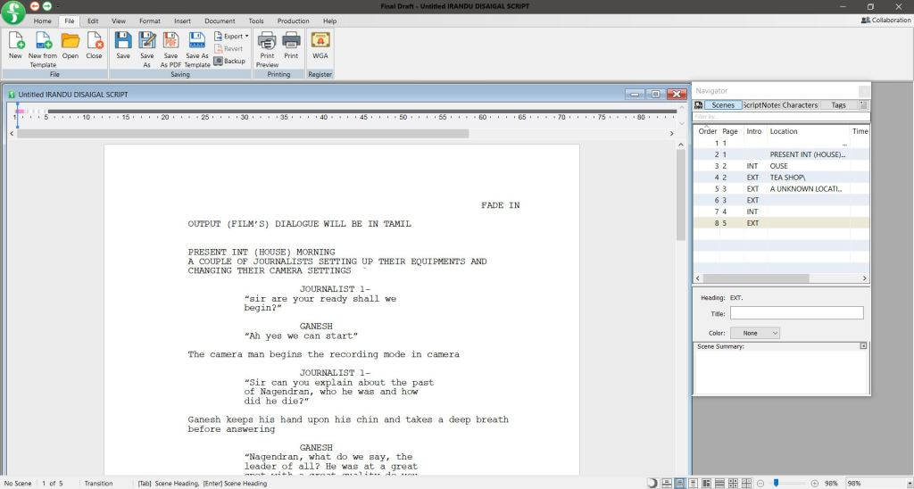
This plan supported me to apprehend the quantity of effort put into producing a film. I produced my film individually which encouraged me to acquire a lot of technical aspects while producing a film, right from scratch from writing the script, making a storyboard, making a shot list, shooting and editing. I previously had a conception about how films are produced and how each viewpoint applauds each other to finish the film
SCRIPT
Irandu Disaigal script is pretty much straightforward to follow it consist more dialogues because the whole short film takes 5 minutes therefore it consist of more dialogues compared my first short film I utilised Final draft an exclusive software to produce script additionally it retains all the features that should be present in a script as automated like scenes, character name
I determined that script not only provides dialogues but also provides scene information and shot details as it was my lengthier short film I had to think and equip more time to make one and I also skimmed other film’s script to seize an impression on how to make a lengthier script and it necessitated longer than a month for me to plan script because I required more extra approach besides some guidance was also needed for me to prepare on both shots and dialogues but creating script took less concise time compared to planning it.

Slide 16
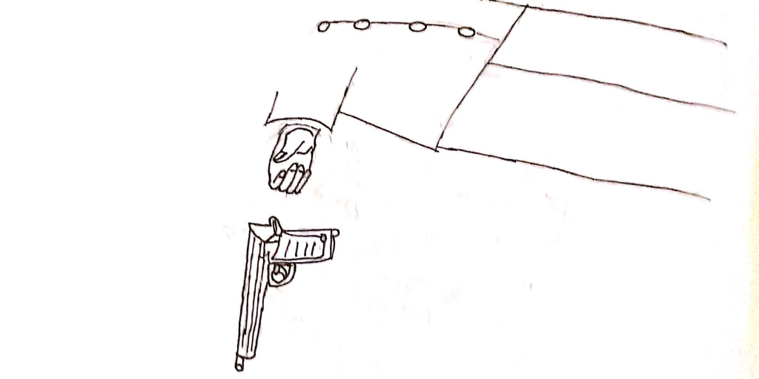
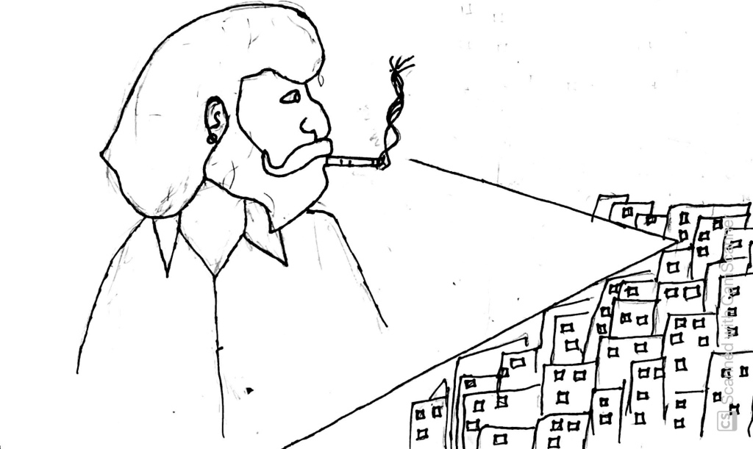
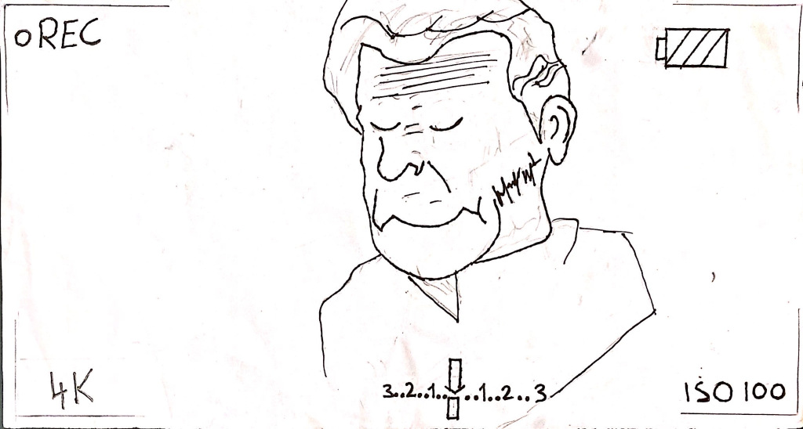
STORYBOARD
For my A levels I had to draw my storyboard, before filming my story I had an idea of how every particular scene has to be ,therefore, I tried to draw every aspect of my thinking of scenes and perhaps it came out well, and since it was paper drawn I used an scanner to take it to the digital screen. Which almost convincingly gave me an good impression therefore I did not require any software to produce the storyboard.

Slide 17
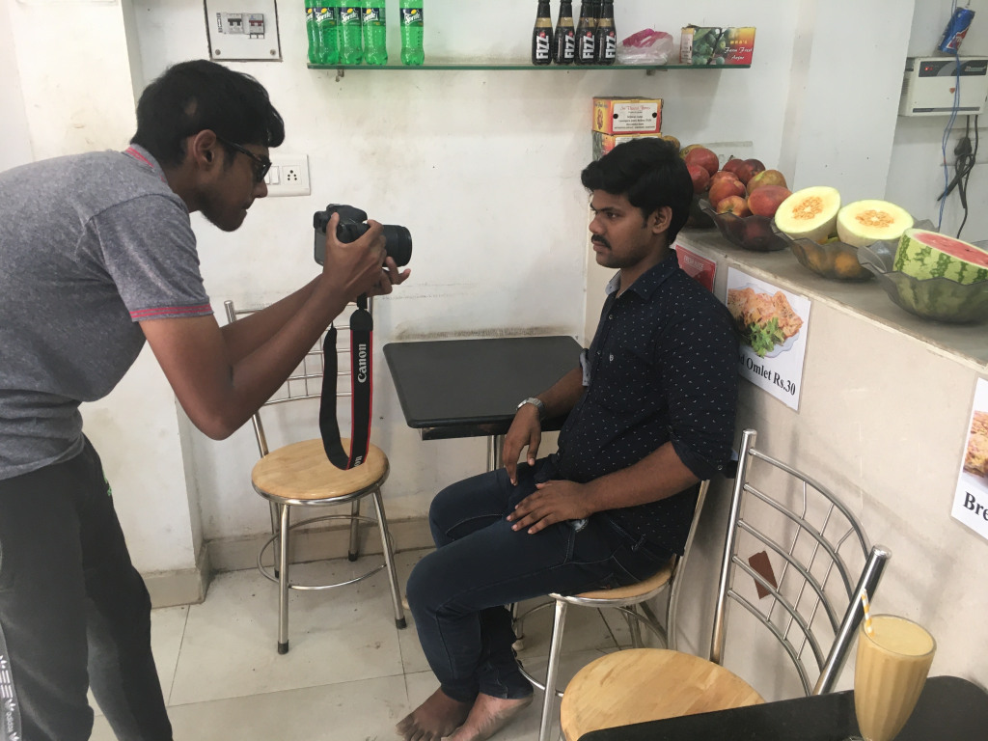
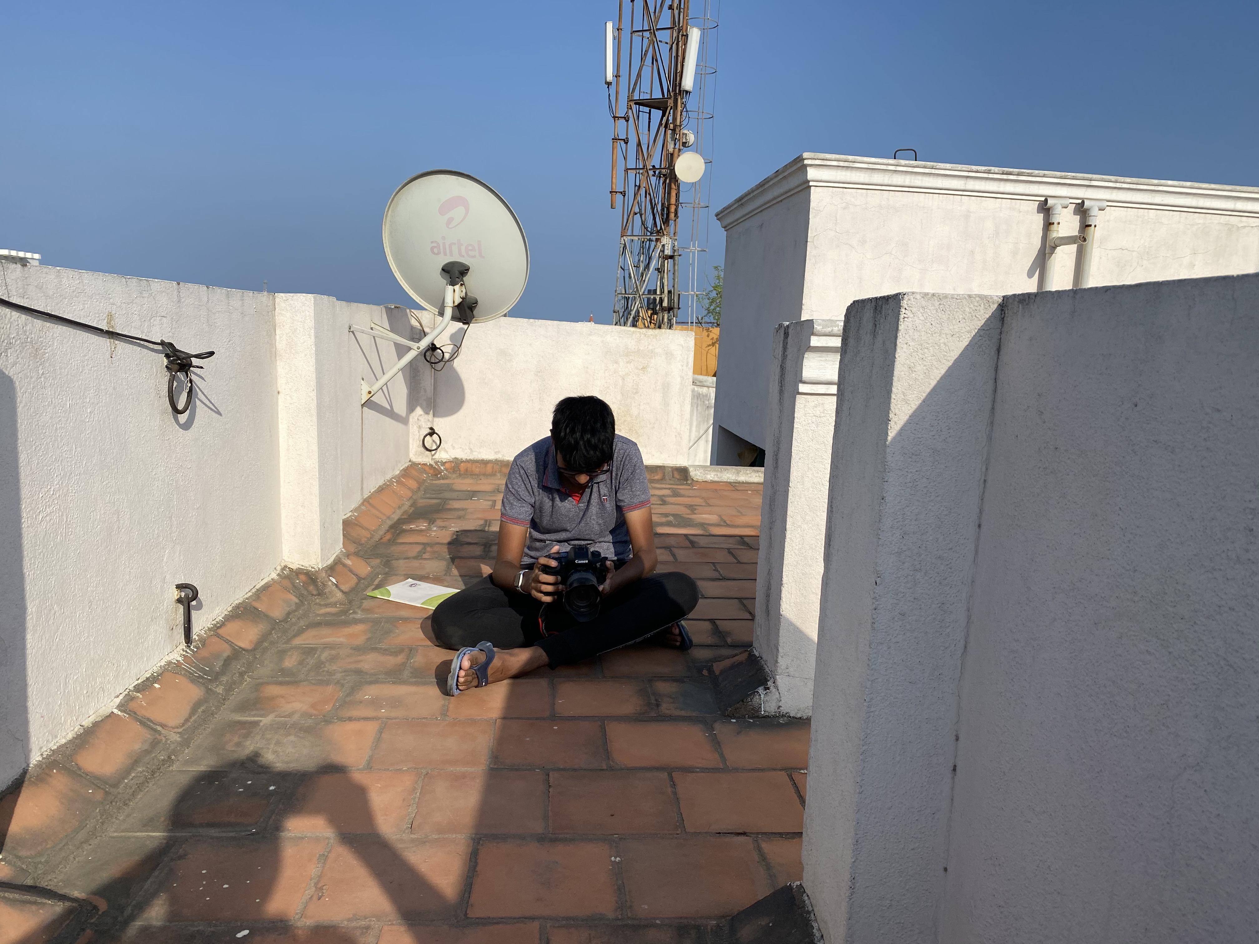
CINEMATOGRAPHY
•Cinematography is one the aspect I largely loved working on, in this portion I have learnt variation of all prospects in cinematography like framing composing, shots, angles and lighting, as mentioned my film has two characters with two distinct objects to represent them one is an cigarette to represent an gangster and a coffee mug to represent a college student mostly I operated the camera as a handheld because I wanted to take the whole film as handheld without any stable materials because we need to equip various methods while filming an particular sequence.

Slide 18
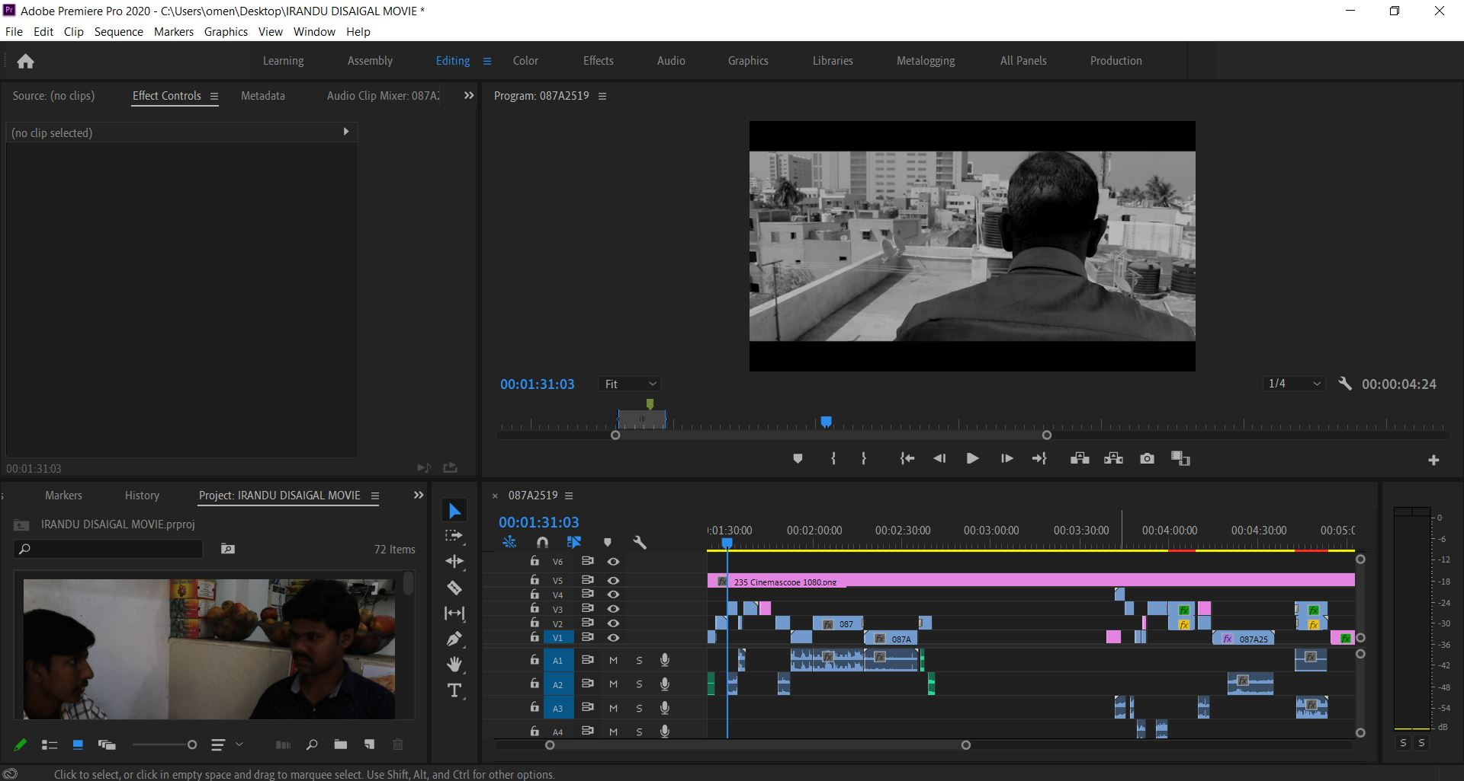
EDITING
•I used premiere pro to edit my raw footages by adding transitions, sounds and colour grading, I used the same software in my As level and in A levels I learnt various techniques and it was kind of easy to work on this software as it gave various prospects like creating own title colour grading and adding sounds, I did not record live audio so I had to dub for dialogues from casts who acted in Irandu Disaigal I wanted an exact slang which could be understood by local audience within Chennai therefore I made the casts to speak an distinct Tamil which is spoken by most Chennaites. People call it local Tamil

Slide 19
How did you integrate technologies- software, hardware, and online in this project?

Slide 20
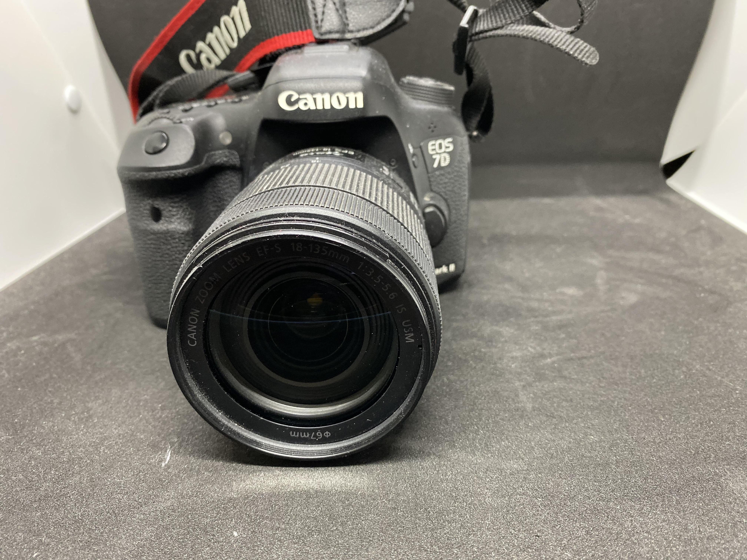
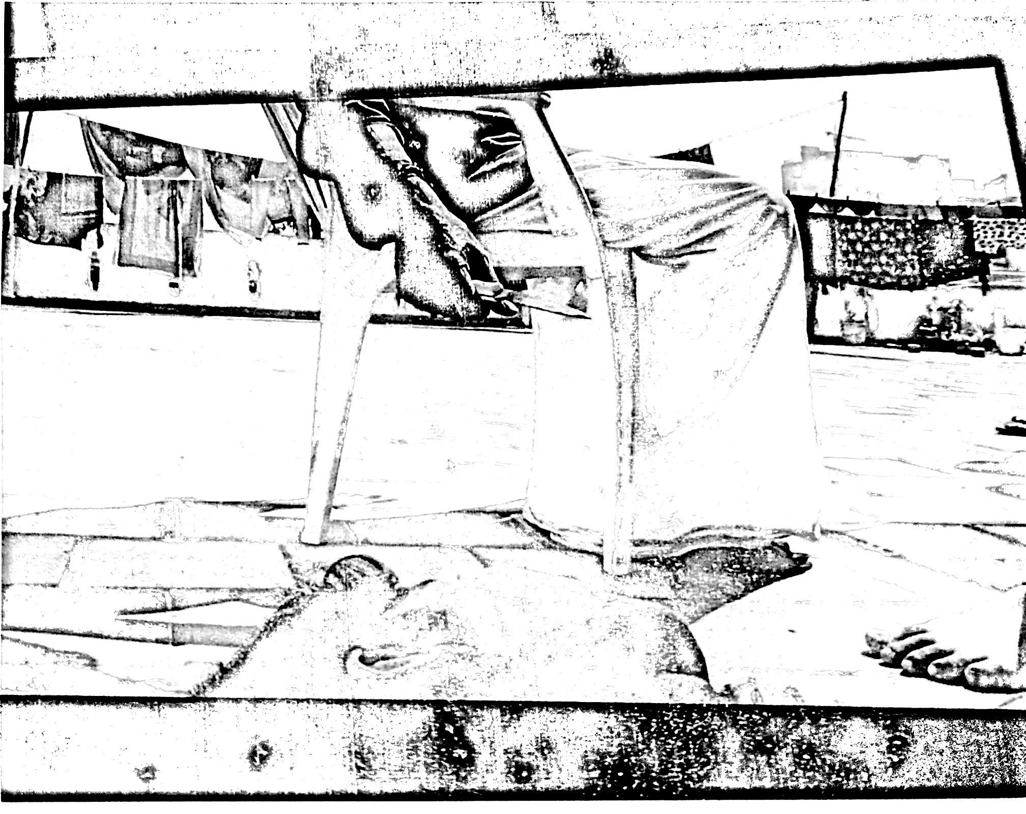
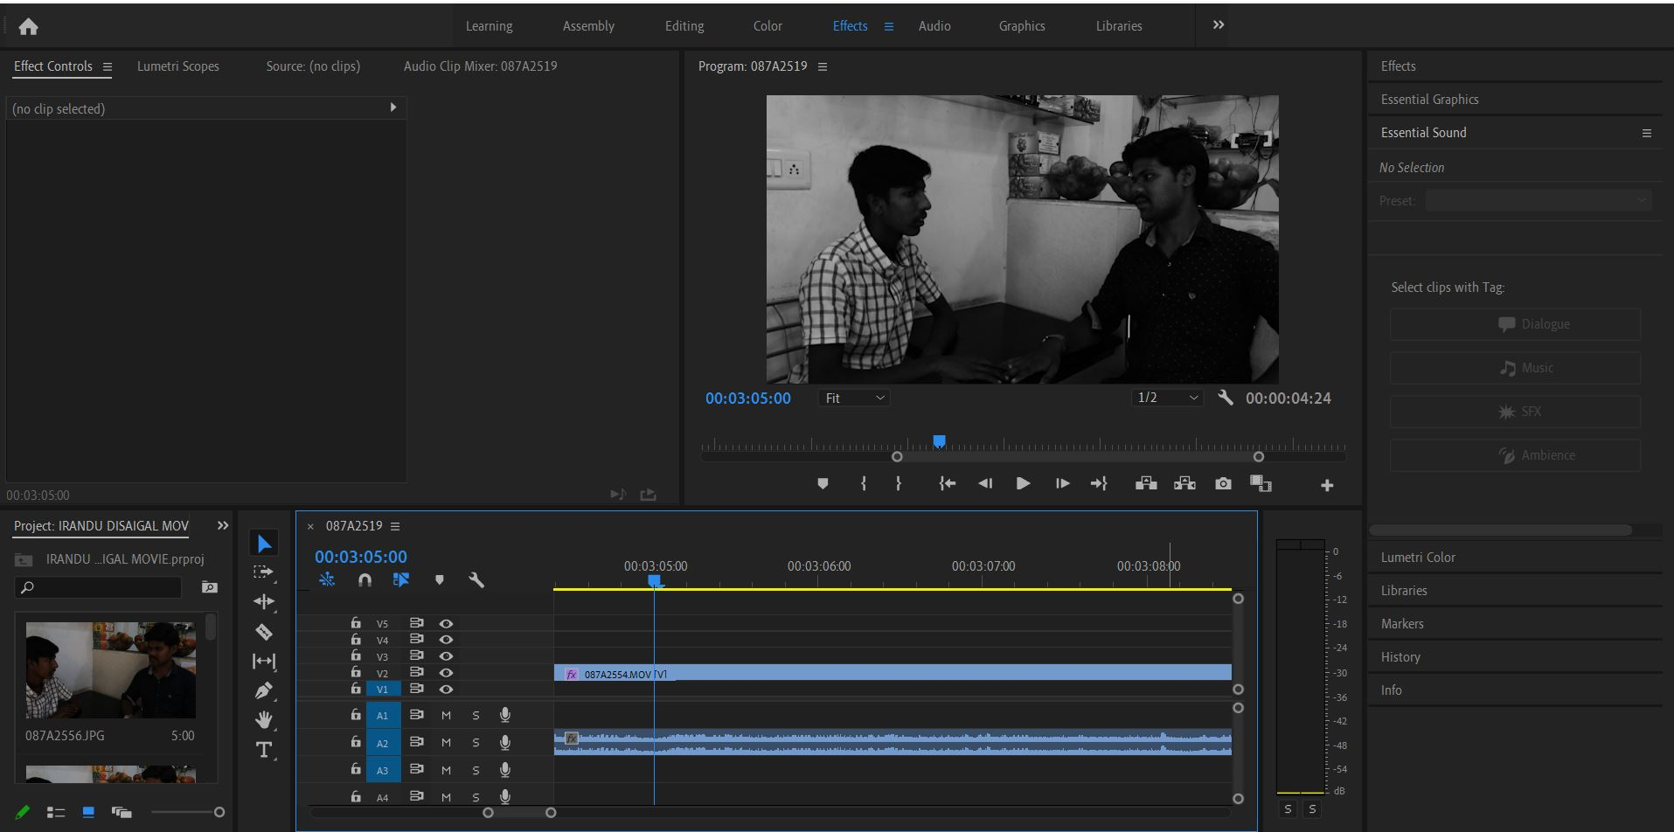
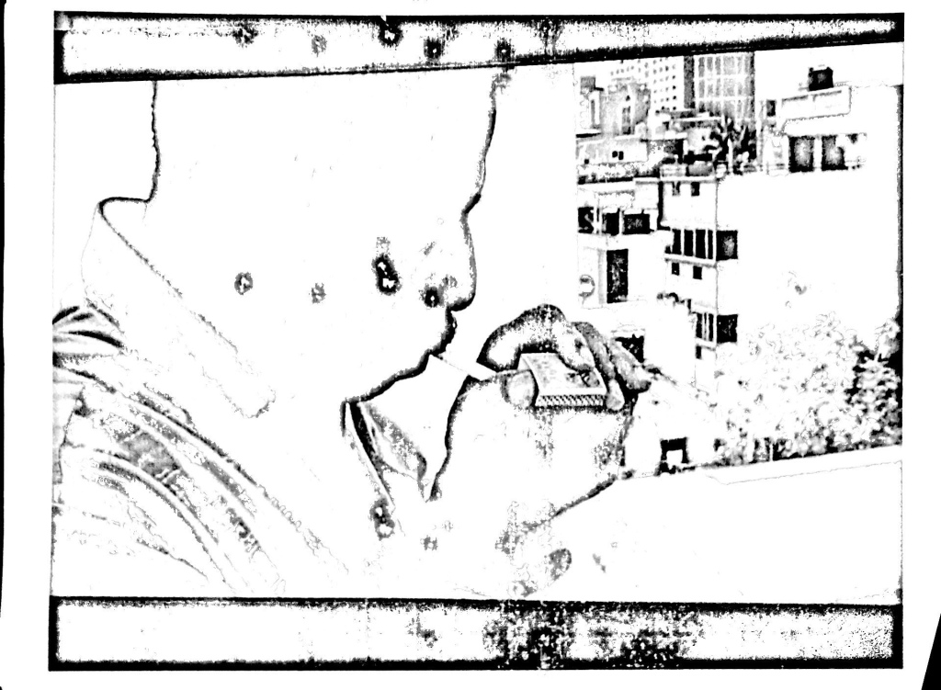
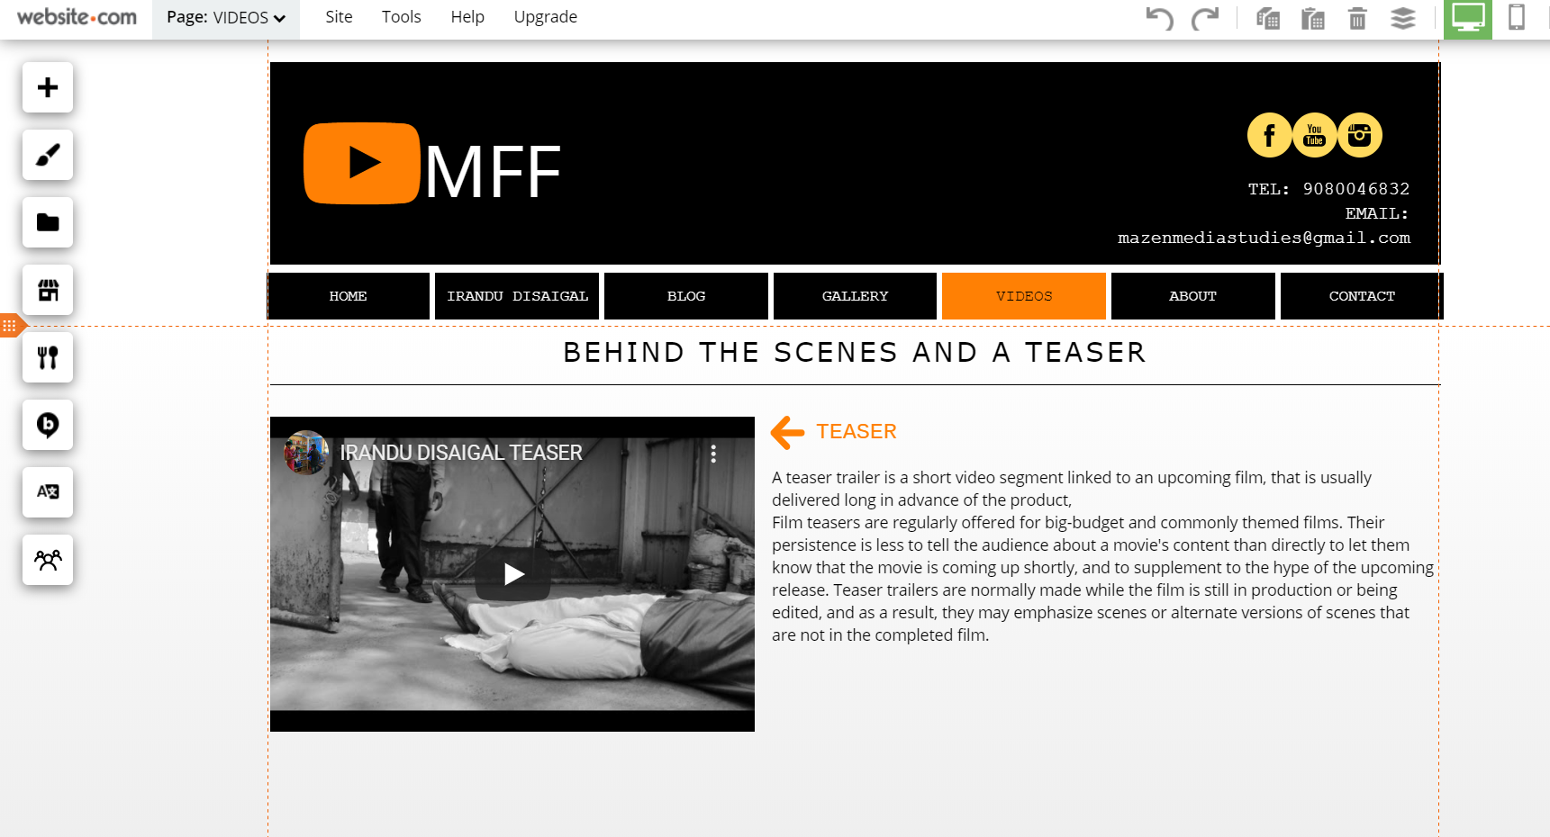
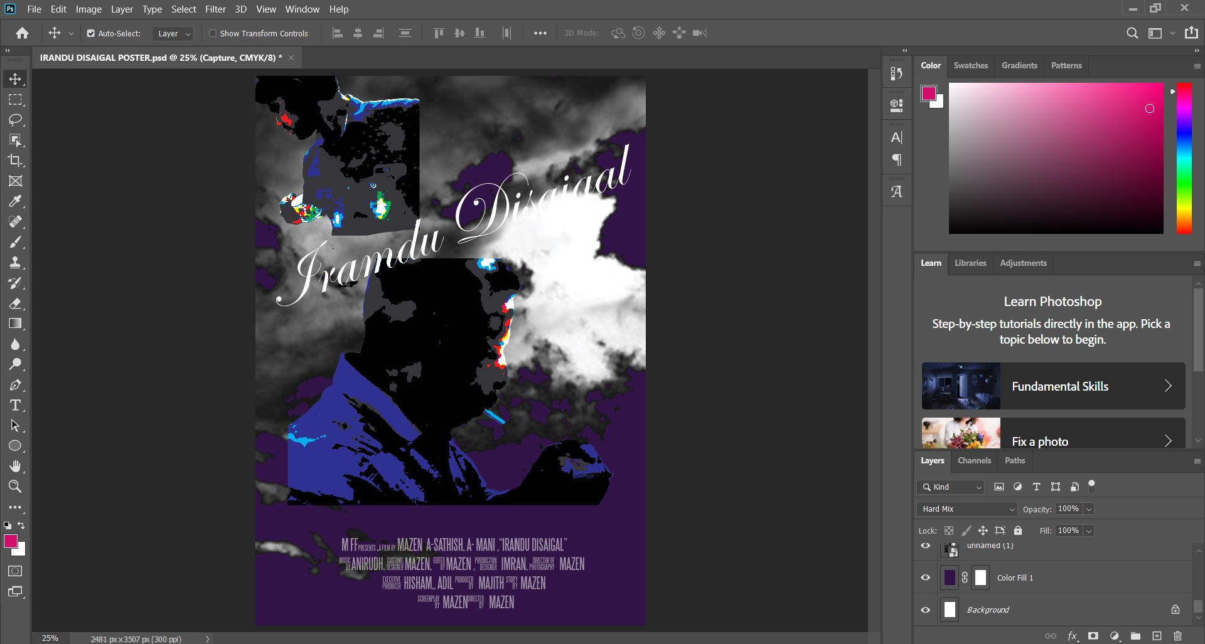
SOFTWARES
POSTER- Adobe photoshop
SCRIPT- Final Draft an exclusive software to produce script (Script template)
STORYBOARD- rough sketch
EDITING- Premier pro
CRITICAL ANALYSIS- Power point and a Podcast
HARDWARES
CAMERA- Canon 7D
LENS- 18-135mm F3.5
LIGHTING- Natural lighting source (SUNLIGHT) mostly the scenes in the film has day scenes and no lowlight scenes
PROPS- Gun, Knife, Cigarette
ONLINE
BLOG-WordPress
FILM WEBSITE- Website.com
FILM- YouTube
SOUNDS-Free sound.net

Slide 21
I have compiled all three aspects of Software's, hardware and online to produce a film (Irandu Disaigal) due to this compilation I had a perfect output and without them it would have not been this simple they three played a greater and a most vital role and a good media product cannot be achieved without all three aspects joined together
I have used adobe premier pro for editing videos, it supported me by letting me to combine all the videos together it also aided me by letting me to colour correct the videos by adjusting exposure and contrast levels this was user friendly it had inbuilt presets of transitions and in past people did not have these technologies they had film roles and they stick it to another film role to present an transition effect but now it is not the same case every digitalized and without this technology I would not have been able to produce the media output.
I used final draft to make script, it was very easy to construct script because I happen to type and correcting the mistake was very easy and I could easily carry the script where ever I wanted with a digital device but that was not the case at the past people happen to write it down and correcting it would be very tough and they could not carry bunch of long sheets where ever they go so these technologies paid a vital role in my film production

Slide 22
•For blog I used WordPress, I used this to update my progressive report of my coursework very often which supported me in the terms of keeping things on right track and up to date as well it also helped me to check some posts for a reference, I primarily upload my blog with various film’s techniques, about genre’s and some important information’s on filming
I even created a film website to share every moment occurrences in shooting spots and memorable experiences
•The means of operating on this project has determined amazingly enjoyable as well as a comprehensive experience, and ‘Irandu Disaigal’ will probably be appealing to anyone who observes it so I assume that the public would relish every scene they observe I suppose it receives more response as I have performed all my handwork on the film with multiple struggles moreover the whole film was taken during the corona virus breakout.

